Slide 1

Rental Bike Company
Rouhollah ebrahimabadi

Slide 2
Simple statistic
There are 789 number of pick up or drop off points around London.
From 2020-12-31 to 2022-07-06 15.5 million time bike were rented.
On average 28345 times consumers rent a bicycle per day.

Slide 3
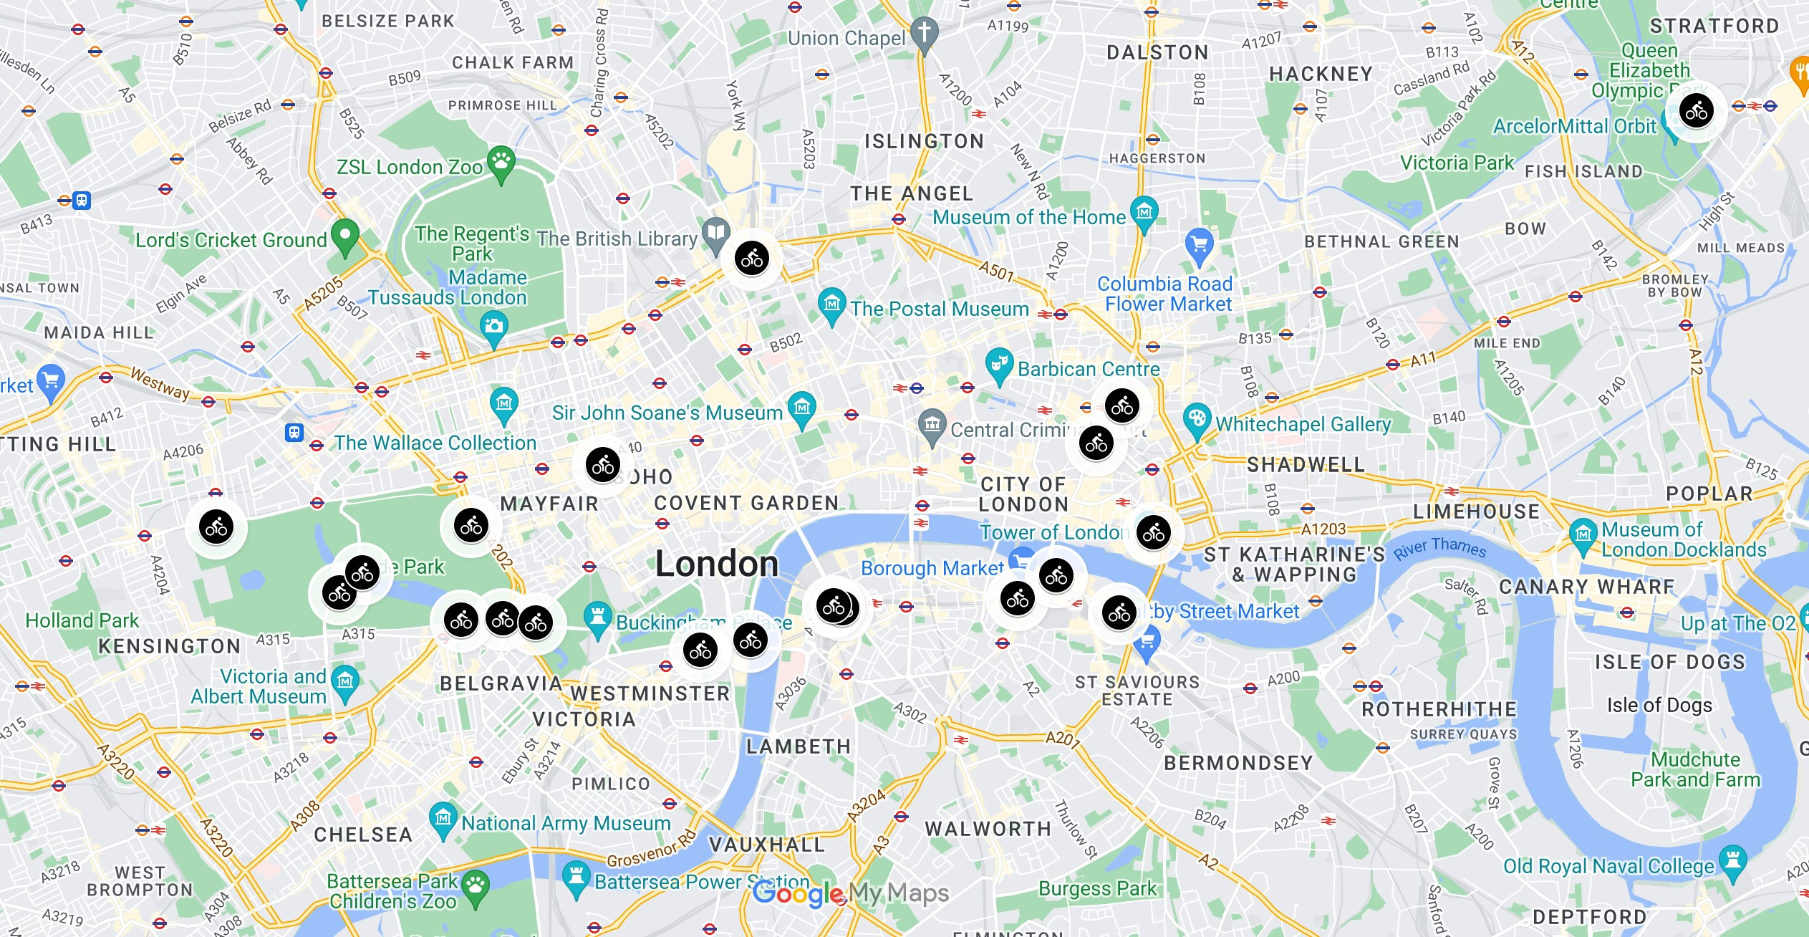
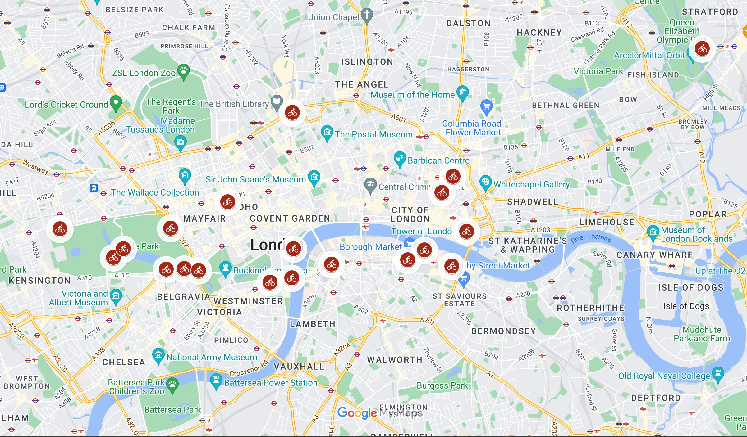
Consumer’s Behaviour
Top 20 drop off and pick up location are almost identical.
Routes are identified by starting and ending point of each journey.
18 out of 20 top routes, are sharing same pickup and drop off location.
Similarly, 18 highest round trips ended where the bike is picked up.
Most common routes, starting, and ending location suggests that most customers are using the bikes for pleasure and sightseeing.
Top 20 pick up locations
Top 20 drop off locations

Slide 4
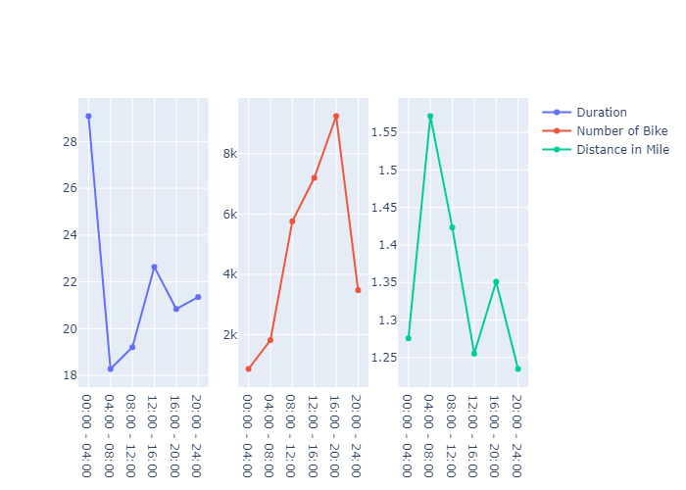
Usage in Different Parts of The Day
Each 24 hours is divided into 6 parts (every 4 hours).
On average between 00:00 to 04:00 the duration of trip are nearly 30 minutes, even though the number of bikes were rented are much lower.
From 08:00 the demand for bikes start raising dramatically till 20:00 (from 2 thousand to more than 8 thousand).
the fluctuation in travelled distance negligible.

Slide 5
Suggestions
Based on average usage, it is suggested bike repair, maintenance, and moving them from least demanded location to higher location take place between hours 20:00 to 04:00 next day since.
We suggest dynamic pricing system based on location and time of the day. This might yield higher profit and lower cost.
For instance the difference of average number of bike picked up and dropped off in Waterloo area between 08:00 to12:00 is 52. This shows higher demand more in that peridural location/time.
On the other hand on average 75 bike is dropped at same location from 16:00 to 20:00.
Charging higher for highly demanded location will generate higher profits and prevent shortage of availability in that location
If lower fare or no fees applied if the costumer travel from highly concentrated are to most demanded location will increases the company brand popularity. In addition it will reduce the cost since less bicycle need to be moved around the city by company.

